Slide 1



NVDLA PDP
Cong Liu
16/11/2007

Slide 2
Support Functions
maximum-pooling
minimum-pooling
average-pooling

Slide 3
Architecture

Slide 4
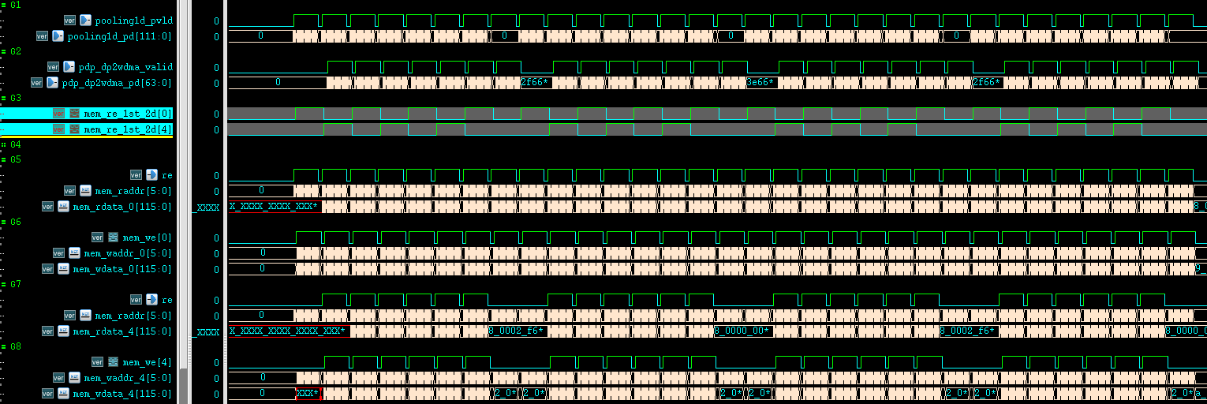
Cal2d
Output_w | 7
Output_h | 7
Output_c | 64
ksize | 2x2
stride | 1
$$Buffer_size=feature_width×K$$
K suggestion:
K=N * kernal_size_MAC_matrix
N*K = total_kernal_num

Slide 5
Liner Buffer
ksize | 2x2
stride | 1
fsize | 7x7
ksize | 3x3
stride | 1
fsize | 7x7

Slide 6
Thank you !
Discussion

